Slide 1



Advancing Million Hearts by Predicting possibility of cardio vascular disease
Student Name: Shilpa Nayak
Assisted by : Dr. Itauma Itauma

Slide 2
Project Goal
Project goal: Our Project goal is to predict the possibility of a individual having cardiovascular disease or not based on various parameters specified in the dataset provided by Svetlana Ulianova on Kaggle.
Submission Date : 7-May-2023
Professor : Dr. Itauma Itauma
Project Executer : Shilpa Nayak
Field of Research : Healthcare
Project Source : Kaggle Dataset
ML/AI technologies : a. Simple Neural Network
b. Logistic Regression/Random Forest
c. NLTK

Slide 3
types of cardiovascular diseases
Cardiovascular diseases (CVDs) heart and blood vessels diseaseswhich include:
Coronary heart disease
Cerebrovascular disease
Peripheral arterial disease
Congenital heart disease
Rheumatic heart disease

Slide 4
VARIABLE DESCRIPTION
Many people die annually from CVDs than from any other cause. An estimated 17.9 million people died from CVDs in 2021, which would be 31% of all global deaths. A total of 85% is due to heart attack and stroke.
Dataset: https://www.kaggle.com/code/sulianova/eda-cardiovascular-data
Dataset contains the following Features:
id:special ID number
gender:gender of an individual
age:age of an individual
height:height of an individual (cms)
ap_hi:Systolic blood pressure (120mmhg or less)
weight:weigh of an individual (kg)

Slide 5
ap_low:Diastolic blood pressure
cholesterol:Cholestreol value .Cholestreol is type of fat found in your blood flow.Adults, 200 mg/dL is acceptable , 200 and 239 mg/dL as Boderline High.This has 3 cathegorical values 1- Normal, 2 - Above Normal, 3 - High
cardio:Target Value which is also Binary 0 - No cardiovascular disease found 1 - have cardiovascular disease.
smoke:0 - non smoker. 1 - smoker.Binary value
active:0 - not active physically. 1-active physically
alco:0 - non alcoholic. 1 - alcoholic.Binary value
gluc:Glucose Level. Individuals without diabetes Glucose level will range between around 70 to 80 mg/dL

Slide 6
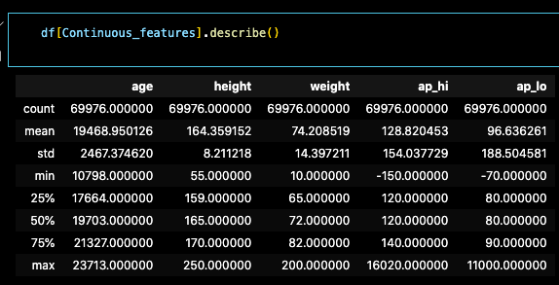
Distribution of the Numerical Values

Slide 7
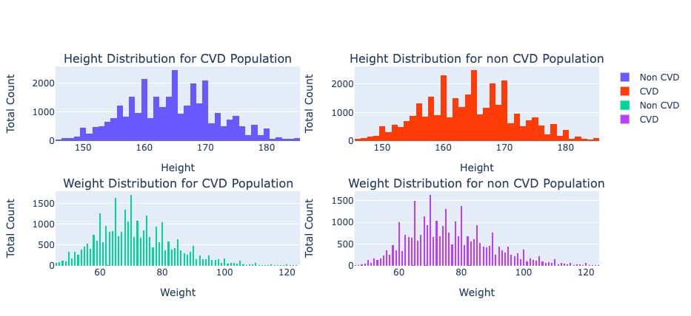
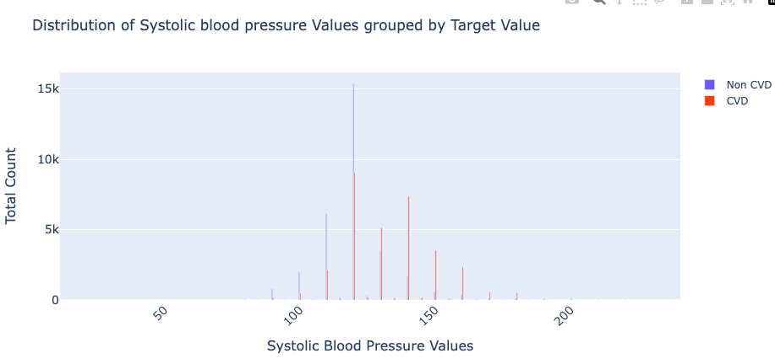
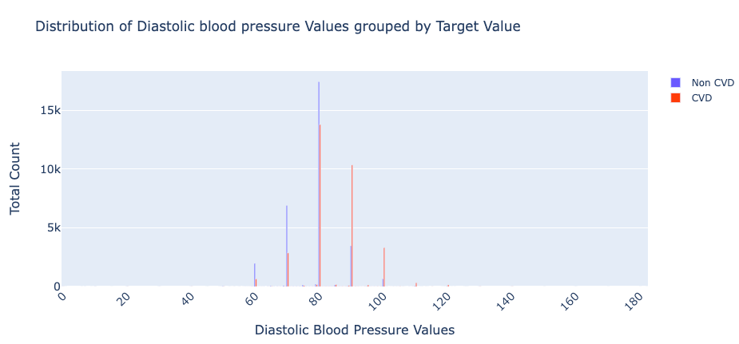
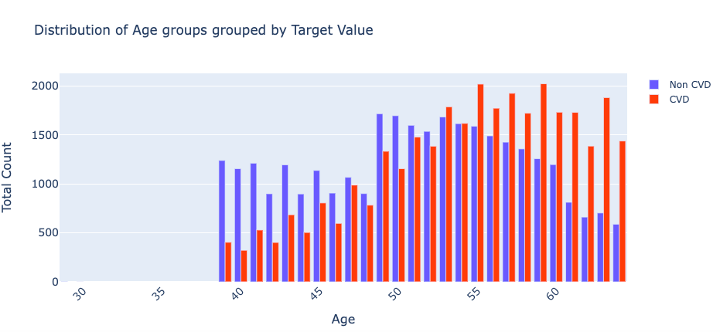
DISTRIBUTION

Slide 8
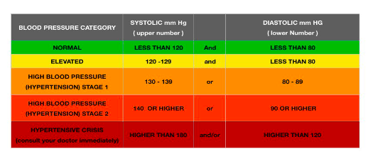
BLOOD PRESSURE Category

Slide 9
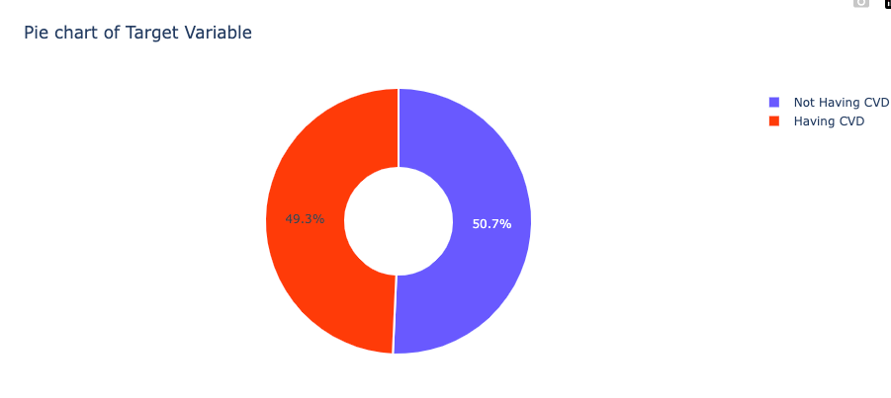

Slide 10
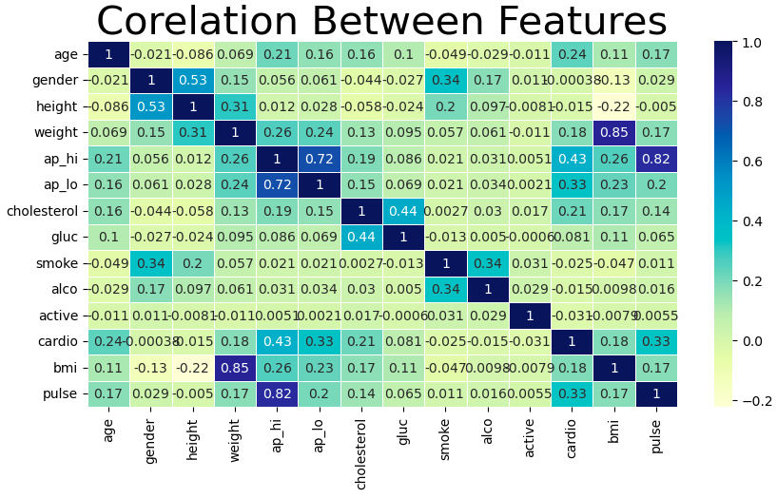
Confusion matrix

Slide 11
fEATURE SELECTION BASED ON CONFUSION MATRIX
ap_hi
pulse
ap_lo
Cholestrol levels
Our newly formed varibale 'bmi' doesn't have good correlation with target
'gender' is the least correlated feature.
height, smoke, alco, active have low correlation with target variable
We are dropping bmi,weight,gluc,gender,height,smoke,alco,active due to less correlation.

Slide 12
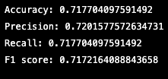
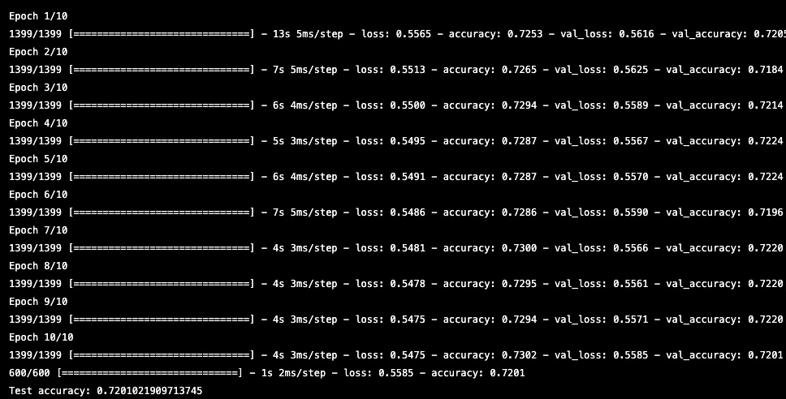
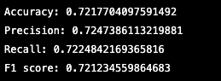
MODEL EVALUATION
Logistic regression Simple neural network model with 2 hidden layers Random Forest

Slide 13

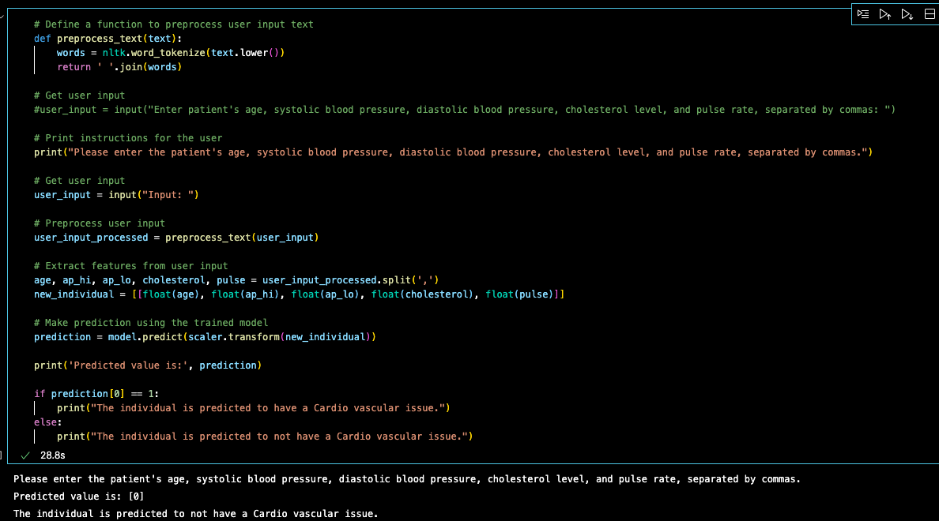
preprocess text data USING NLTK

Slide 14

Thank You
QUESTIONS ?

